Slide 1
Implementing DevOps practices to accelerate developer productivity

Slide 2
Setup Development Environment
Exercise 1

Slide 3
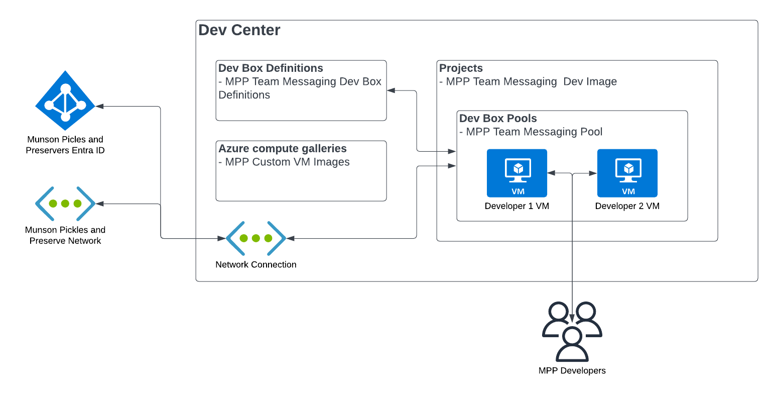
Lab 1 Architecture
Azure Dev Box
Notes:
The Challenges will focus on the following parts of the Petclinic solution:
Challenge 02: Migrate a Spring Apps microservices application to Azure Kubernetes Service

Slide 4
Introductions: Set up development environment
In this lab, you’ll setup a development environment
After completing this lab, you’ll be able to:
Deploy the necessary infrastructure for an Azure Dev Box
Create an image for your Dev Box
Create a Dev Box
Grant users permissions to create and access their Dev Box
Notes:
Speaker notes:
In the previous lab, you established a plan for migrating the Spring Petclinic application to the Azure platform. It's now time to perform the actual migration of the first Spring Petclinic components.
The Spring Cloud service provides a config server for your sample apps to use.
In this lab, you'll begin by creating a Git repo. After you've created the Git repo, you'll create a config server for your Spring Cloud instance to connect to your Git repo. You'll then create a MySQL database service. After the MySQL database service in place, you can deploy the microservices to the Azure Spring Apps service. Lastly, you'll test the application through a publicly available endpoint to make sure everything is working.
Learning objectives
After completing this lab, you'll be able to:
Create an Azure Spring Apps Enterprise service
Set up the config repository
Set up the Application Configuration Service for Azure Spring Apps Enterprise
Create an Azure MySQL Database service
Deploy the Spring Petclinic app components to the Spring Apps service
Provide a publicly available endpoints for the Spring Petclinic application
Test the application through the publicly available endpoints

Slide 5
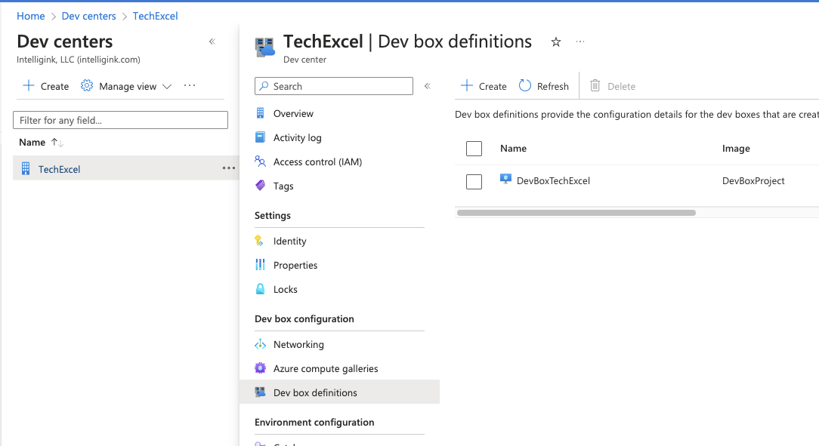
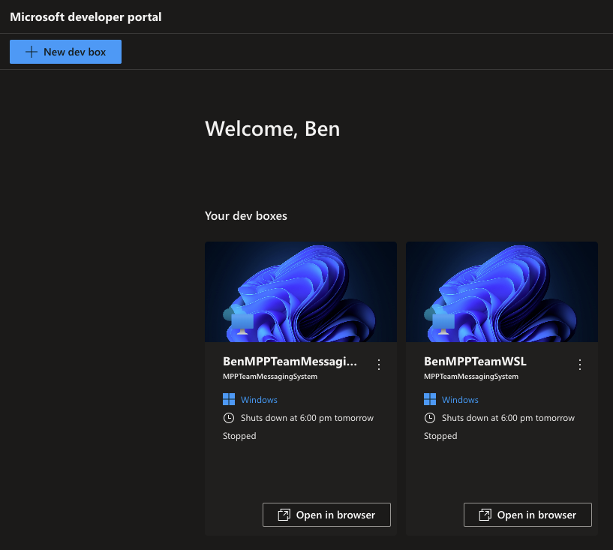
Create a Dev Box definition
Notes:
Speaker notes:
Azure Spring Apps is a platform as a service (PaaS) for Spring developers. Manage the lifecycle of your Spring Boot applications with comprehensive monitoring and diagnostics, configuration management, service discovery, CI/CD integration, and blue-green deployments.
Use the procedures to deploy an instance of Azure Spring Apps.

Slide 6
Start working in GitHub

Slide 7
Introductions: Start working in GitHub
In this lab, you’ll begin by creating a GitHub repository. From there, you will create a GitHub Project and associate issues with that project. Finally, you will create a simple GitHub Actions workflow.
After completing this lab, you’ll be able to:
Create a GitHub repository.
Create a GitHub Project.
Assign issues to teammates and navigate a project board.
Add custom fields to issues.
Create a GitHub Actions workflow.
Extend a GitHub Actions workflow with multiple jobs.
Incorporate workflow actions from the GitHub Marketplace.
Notes:
Speaker notes:
In the previous lab, you create a Dev Box to perform development work.
In this lab, you will create a GitHub repository and work through some of the mechanics of GitOps, including project board management, issue management, and the creation of a GitHub Actions workflow.
Learning objectives
After completing this lab, you'll be able to:
Create a GitHub repository
Create a GitHub Project
Assign issues to teammates and navigate a project board
Add custom fields to issues
Create a GitHub Actions workflow
Extend a GitHub Actions workflow with multiple jobs
Incorporate workflow actions from the GitHub Marketplace

Slide 8
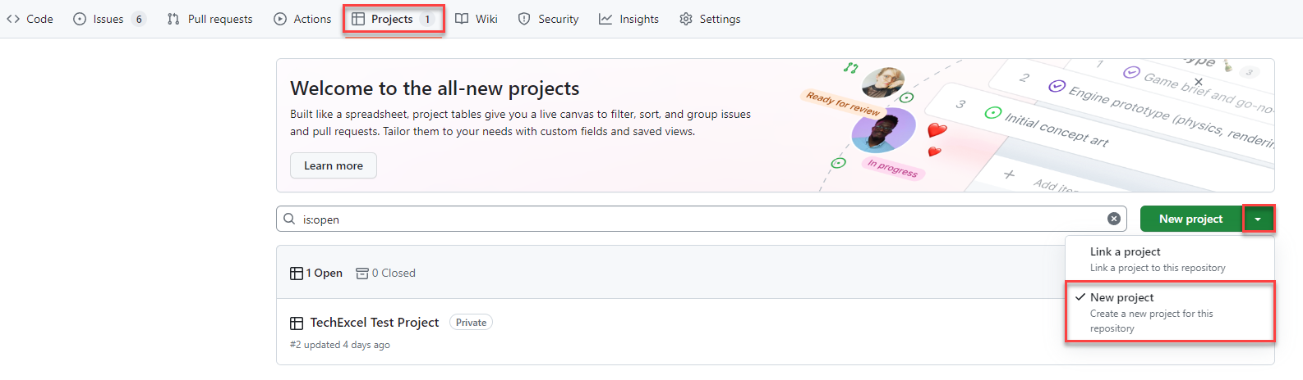
Create a GitHub Project
Notes:
Speaker notes:
GitHub Projects allow development teams and project managers to manage issues, using either a scrum or kanban motif.

Slide 9
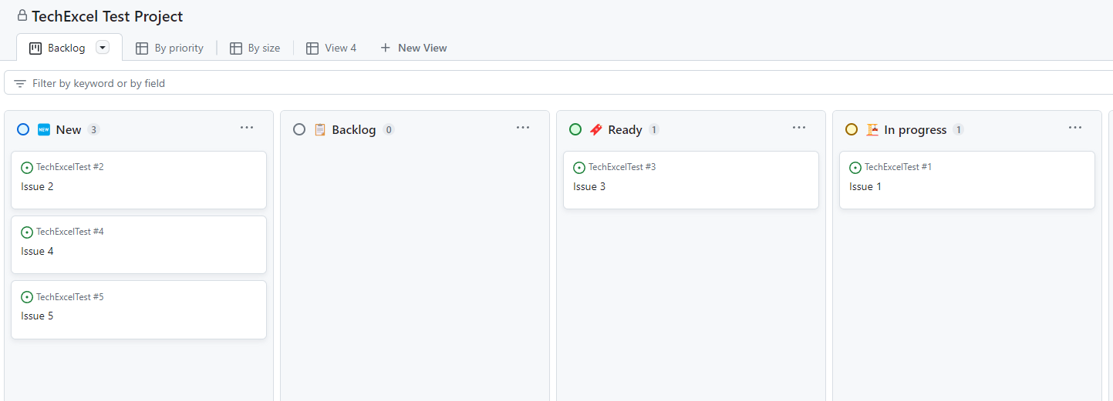
Navigate the project board
Notes:
Speaker notes:
You will create a series of issues on a project board and see how you can manipulate the board to keep track of the status of issues. You will assign issues to teammates and add a custom field to issues.

Slide 10
Create a GitHub Actions workflow
You’ll create the first of several GitHub Actions workflows.
name: First Workflow
on:
workflow_dispatch:
issues:
types: [opened]
jobs:
job1:
runs-on: ubuntu-latest
steps:
- name: Step one
run: echo "Log from step one"
- name: Step two
run: echo "Log from step two"
job2:
needs: job1
runs-on: ubuntu-latest
steps:
- name: Cowsays
uses: mscoutermarsh/cowsays-action@master
with:
text: 'Ready for prod--ship it!'
color: 'magenta'
Allow the workflow to run manually.
Each workflow has one or more jobs. We will create two jobs.
Each workflow job has one or more steps.
You’ll include the cowsays action from the GitHub Marketplace.
Notes:
Speaker notes:
GitHub Actions workflows allow you to perform actions on specific events, such as push code into a branch, creating a pull request, creating an issue, or manual execution.
For this first workflow, you will create a workflow which executes manually. In it, there will be two jobs. The first job will write statements into logs. The second will use the “cowsays” action from the GitHub Marketplace to write a statement into the logs.

Slide 11
Improve and deploy your application

Slide 12




Lab 3 Architecture
Munson’s Pickles & Preserves application architecture
App Service Plan
App Insights
App Service (Dev)
App Service (Test)
App Service (Prod)
Container Registry
Notes:
This lab will focus on deploying the Munson’s Pickles and Preserves Team Messaging System application into Azure.

Slide 13
Introductions: Improve and deploy your application
In this lab, you’ll deploy Azure resources and introduce CI/CD pipelines to your GitHub repo.
After completing this lab, you’ll be able to:
Configure GitHub Copilot and use it to assist with C# code changes.
Deploy ARM and Bicep templates via GitHub Actions workflow.
Create a GitHub Actions workflow for deploying .NET web applications.
Automatically build and deploy a Docker image as part of a workflow.
Update an Azure Web App whenever the GitHub Actions workflow deploys a new Docker image.
Notes:
Speaker notes:
You've created a GitHub repository containing application code and a Bicep script. In this lab, you will create resources in an Azure resource group, including an App Service Plan, three App Services, one Application Insights service, and one Container Registry. You will also use GitHub Copilot in Visual Studio Code to assist you with making a change to the Team Messaging System.
After deploying Azure resources, you will create a new GitHub Actions workflow that builds and deploys a Docker container image based on the .NET web application code. Then, whenever the application code changes, you will build a new image, deploy it to the Container Registry, and use that new image in your App Services.
Learning objectives
After completing this lab, you'll be able to:
Configure GitHub Copilot and use it to assist with C# code changes
Deploy ARM and Bicep templates via GitHub Actions workflow
Create a GitHub Actions workflow for deploying .NET web applications
Automatically build and deploy a Docker image as part of the workflow
Update an Azure Web App whenever the GitHub Actions workflow deploys a new Docker image

Slide 14
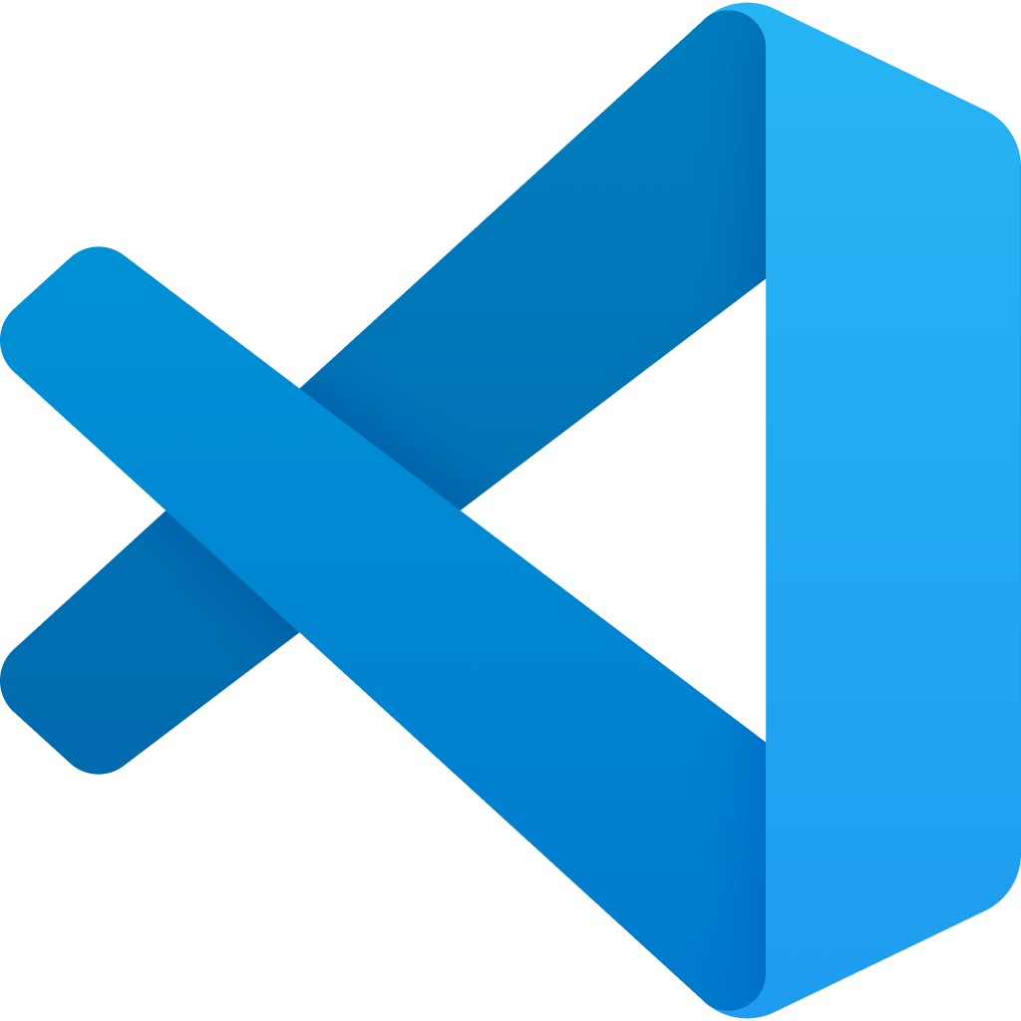
Follow the GitHub Flow
The GitHub Flow is a common process for managing code changes through GitHub.
Create a GitHub Issue
Create a feature branch
Fetch repo changes locally
VS Code
Commit and push changes
GitHub allows you to tie issues, branches, and pull requests together, letting GitHub close issues and delete feature branches after code moves to the main branch.
Pull request to main
Code review
Complete pull request
Notes:
Speaker notes:
The GitHub flow is a standard process for making code changes in a GitHub repository. There are several steps to the GitHub flow:
Create a GitHub Issue describing the problem you would like to solve. This may involve discussion with team members, project managers, issue reporters, and relevant stakeholders. The GitHub Issue should include enough details to prompt a code change.
Create a new branch. This new branch, called a feature branch, will allow you to work on your code independent of other developers. It will also allow you to experiment without breaking important code release branches like a development or main branch.
After creating the new branch, fetch changes locally and switch to the newly created feature branch. At this point, any changes you make locally will be in the feature branch, isolating your changes from others.
Make any necessary changes in tools like Visual Studio Code. If you have correctly configured Visual Studio Code and installed the C# extension, you should be able to run the .NET web application locally and try it out in a browser.
After you have completed all code changes, you can commit these changes locally. Then, when you are ready to complete the task, you can push your changes to the remote feature branch.
After you have pushed your changes, you can create a pull request. In this case, we will pull request directly to the main branch, though some repositories may have a series of branches such as dev, test, and main.
A teammate should perform a code review of the code in your pull request. This allows a second set of eyes to review the code changes and ensure that these are appropriate and correct changes.
After the code review completes, completing the pull request is the final step. In this process, you may wish to delete the feature branch and close the originating issue.

Slide 15
Deploy a Bicep template
GitHub allows you to execute ARM and Bicep templates as part of a GitHub Actions workflow.
To deploy resources, you will need to log into Azure and then use the arm-deploy action.
- uses: azure/login@v1
with:
creds: ${{ secrets.AZURE_CREDENTIALS }}
- name: Run ARM deploy
uses: azure/arm-deploy@v1
with:
subscriptionId: ${{ secrets.AZURE_SUBSCRIPTION_ID }}
resourceGroupName: ${{ secrets.AZURE_RG }}
template: ./InfrastructureAsCode/main.bicep
parameters: environment=${{ github.event.inputs.appenv }}
The action above will deploy a file called main.bicep to Azure whenever the GitHub Actions workflow runs.
Notes:
Speaker notes:
GitHub allows you to execute ARM and Bicep templates as part of a GitHub Actions workflow. To do this, you can use the azure/arm-deploy action from the GitHub Marketplace. It needs several parameters, including a subscription ID, a resource group name, the location of the ARM or Bicep template file, and a set of input parameters.
The arm-deploy action can work with both ARM and Bicep templates because Bicep is fully translatable into ARM.
You will create a GitHub Actions workflow to perform this operation. In practice, this would allow you to automate resource changes whenever the Bicep template changes, automating your Infrastructure as Code process.

Slide 16
CI/CD for .NET websites with GitHub Actions
Create another GitHub Actions workflow for deploying the website
steps:
- uses: actions/checkout@v3
- name: Setup .NET
uses: actions/setup-dotnet@v3
with:
dotnet-version: 6.0.x
- name: Restore dependencies
run: dotnet restore
- name: Build
run: dotnet build --no-restore
- name: Test
run: dotnet test --no-build
Create a GitHub Actions .NET workflow and configure each of the steps.
Add environment variables to manage deployment.
Build a Docker image from the .NET code and deploy it to Azure Container Registry. Then, update the Web App with that new container image.
Notes:
Speaker notes:
The final step in this lab is to create a Continuous Integration and Continuous Delivery (CI/CD) process for deploying the .NET website. You will use yet another GitHub Actions workflow, this one based around .NET CI/CD. The core of this workflow includes three commands: dotnet restore to restore any dependencies in NuGet packages, dotnet build to compile the application and create binaries, and dotnet test to run unit tests against the compiled binaries.
In addition, you will extend this workflow to build a Docker image from the .NET code and deploy it into an Azure Container Registry. Then, for each newly tagged image, you will update each environment’s Web App with that container image.

Slide 17
Implement load testing secure practices

Slide 18


Lab 4 Architecture
Munson’s Pickles & Preserves application architecture
App Service Plan
App Insights
Chaos Experiment
App Service (Dev)
App Service (Test)
App Service (Prod)
Container Registry
Load Testing
Notes:
This lab will focus on extending the current Azure solution to include load testing and Azure Chaos Studio.

Slide 19
Introductions: Implement load testing and secure practices
In this lab, you’ll create an Apache JMeter load test, use this load test in an Azure Load Test service, and design a chaos experiment using Azure Chaos Studio.
After completing this lab, you’ll be able to:
Design a load test for a web application.
Create a load test using Apache JMeter.
Create an Azure Load Testing service and execute the JMeter load test in Azure.
Design and create a stress test using the Azure Load Testing service.
Design a chaos experiment in Azure Chaos Studio.
Notes:
Speaker notes:
Now that the Team Messaging System website is up and running, it would be beneficial to understand how well the application performs under load. To do this, you will design a load test scenario and then implement it using Apache JMeter, an open source solution for load testing.
After running the load test manually, you will create an Azure Load Testing service. The Load Testing service supports importation of JMeter scripts, so you will be able to use the work you’ve created so far and create a performance baseline for the application. You may also be able to observe performance issues in particular actions, which you can remedy.
After that, you will extend the load test to become a stress test, attempting to push enough traffic at the website to generate failure. You will also use Azure Chaos Studio to generate a chaos experiment, learning how the application behaves when certain services fail.
Learning objectives
After completing this lab, you'll be able to:
Design a load test for a web application
Create a load test using Apache JMeter
Create an Azure Load Testing service and execute the JMeter load test in Azure
Design and create a stress test using the Azure Load Testing service
Design a chaos experiment in Azure Chaos Studio

Slide 20
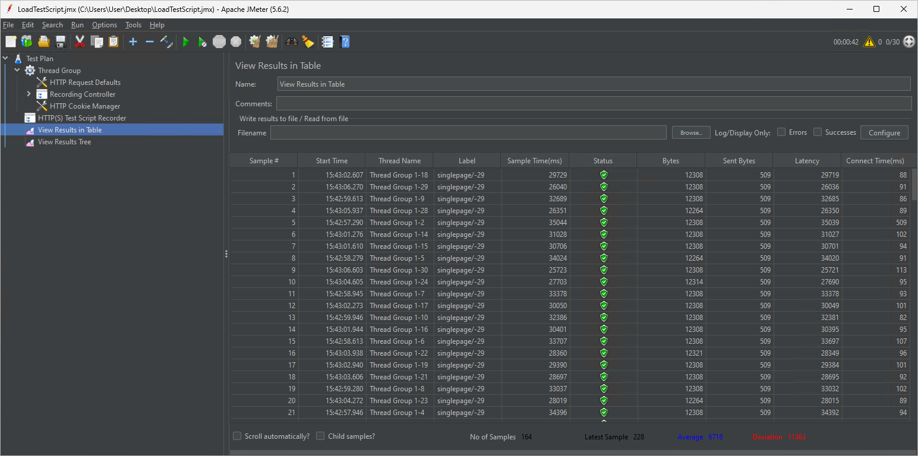
Build and run a load test
Apache JMeter is an open source tool for building and running load test scripts.
Apache JMeter
A load test allows us to simulate a certain amount of traffic against an application to ensure that the application can handle that level of load.
Notes:
Speaker notes:
Apache JMeter is an open source tool for building and running load test scripts. It requires Java 8 or later to be installed and was one of the tools you installed on your Dev Box. You will be able to build a load test using the JMeter GUI, after which you can either run the test in the GUI itself or via command line.
These load tests allow us to simulate a certain amount of traffic against an application. You will design the test and specify how many concurrent users will run this workload. The intent is to ensure that the App Service you created will be able to handle a certain amount of traffic without failure.

Slide 21
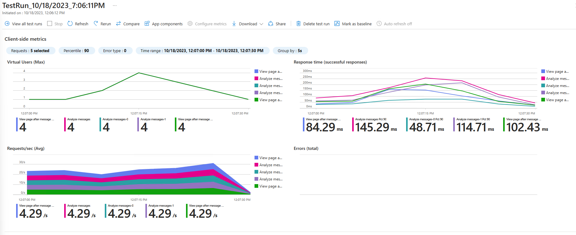
Working with Azure Load Testing
Notes:
Speaker notes:
In addition to running load tests directly via JMeter, you will also create an Azure Load Testing service and run load tests from it. Azure Load Testing accepts JMeter scripts, so you can use the script you have already created as the basis for additional testing. This will provide you with additional information on response times and allow you to link your load test to specific Azure resources and see how the level of load affects those services.
For this lab, you will link the load test to your App Service.

Slide 22
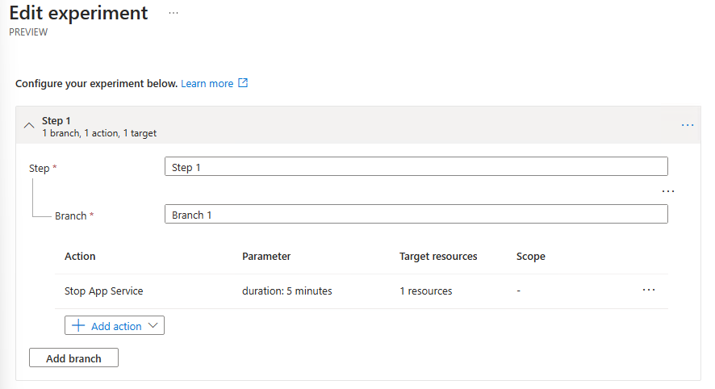
Build an Azure Chaos experiment
You’ll create a chaos experiment to observe behavior when the App Service stops.
Azure Chaos Studio allows us to design experiments that disable resources and test the resiliency of applications.
During the experiment, you will run a load test to simulate activity, observing what happens when a service fails.
Notes:
Speaker notes:
Load testing is not the only form of testing you can run in Azure. You can also run chaos experiments to simulate service failures.
Azure Chaos Studio allows you to design experiments that disable specific resources for a given amount of time. Azure Chaos Studio is currently in preview and supports a limited number of services, so for this lab, we will stop the App Service for a fixed amount of time, seeing how it impacts a running load test.

Slide 23
Make things secure
Exercise 5

Slide 24
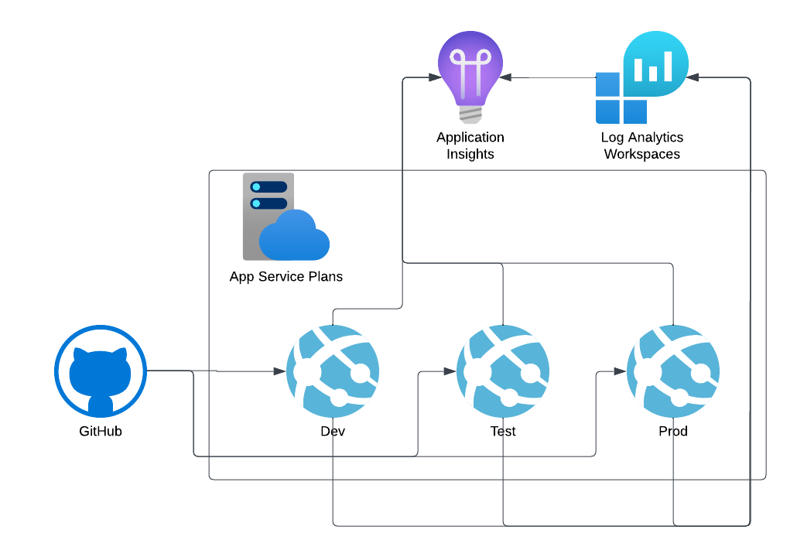
Lab 5 Architecture
Notes:
The Challenges will focus on the following parts of the Petclinic solution: Enable monitoring and end-to-end tracing

Slide 25
Introductions: Security & Monitoring
In this lab, you’ll add security to GitHub and monitoring to you application
After completing this lab, you’ll be able to:
Configure branching in GitHub
Setup protected branches
Setup a GitHub security policy
Configure code security and vulnerability scanning
Create app monitoring dashboards
Configure app availability monitoring
Notes:
Speaker notes:
You've created your first Spring Apps service, installed your microservices as applications, and exposed them through the api-gateway.
Now that everything is up and running, it would be beneficial to monitor your applications availability. Monitoring helps you determine if there are errors or exceptions within your applications.
In this challenge, you'll add end-to-end monitoring to your applications.
Learning objectives
After completing this lab, you'll be able to:
Live stream the logs from your apps
Configure Application Insights to receive monitoring information from your apps
Analyze app-specific monitoring data
Configure diagnostics settings
Analyze logs

Slide 26
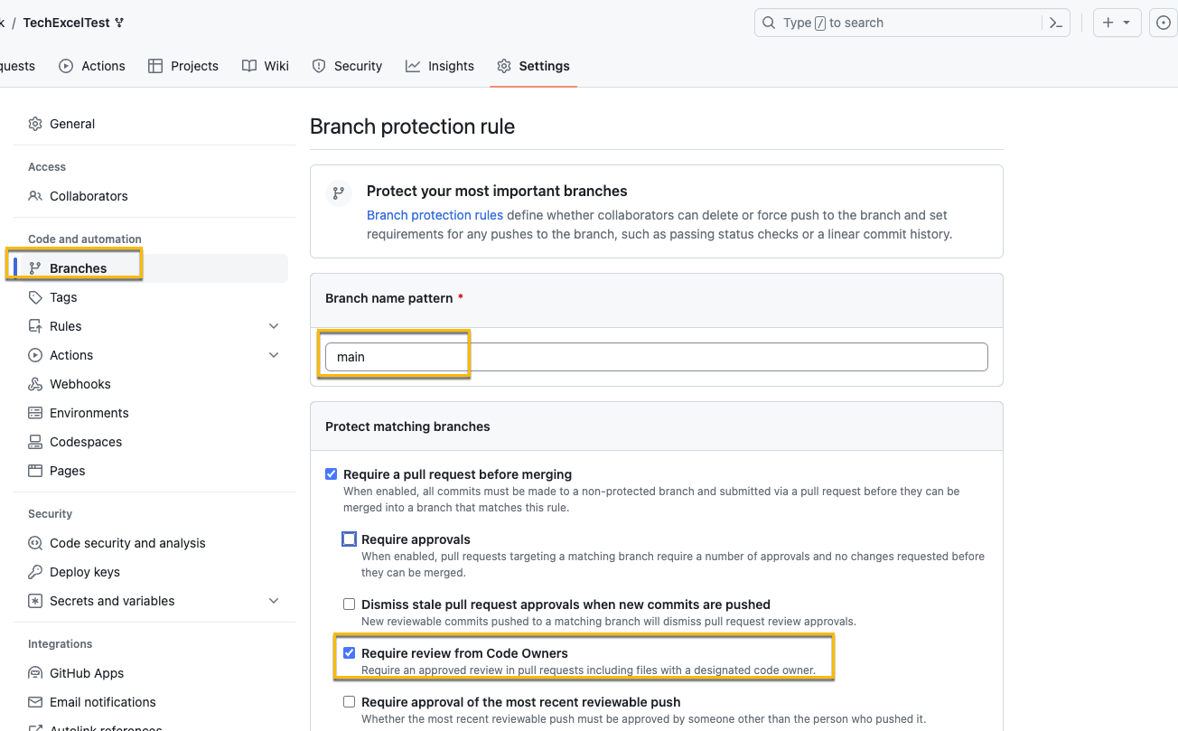
Branch Policies
Branch Policies prevent committing code directly to production without review
The rule above protect the main branch and require review from Code Owners
Notes:
Speaker notes:
Azure Spring Apps enables log streaming using Azure CLI to get real-time application console logs for troubleshooting.
You’ll live stream the logs of the customer and the visits services.
To live stream the logs for the customer service, use the following statements:
az spring app logs \ --name customer-service \ --resource-group $RESOURCE_GROUP \ --service $SPRING_APPS_SERVICE –follow
The action above will stream the customer service app logs to your console.
Switch to the web browser displaying the Spring Petclinic application and navigate throughout the interface. Notice that your actions trigger display of new log entries in the console output.
Enter Ctrl+c to stop streaming the logs.

Slide 27
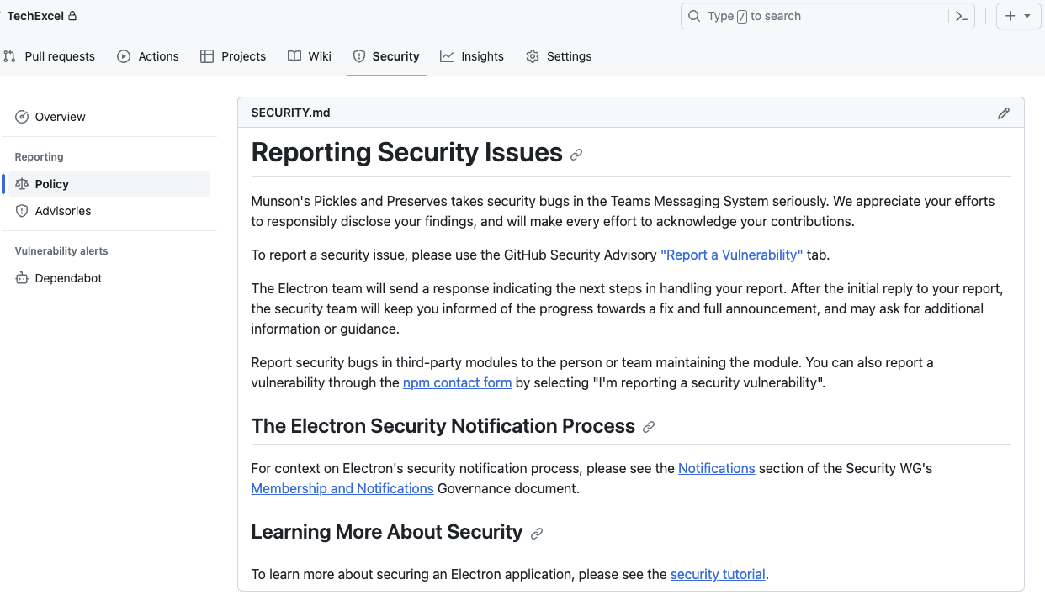
Setup a security policy for a GitHub Repo
GitHub allows you to write your own securityy policy in Markdown and place it into the repo to be surfaced in the security tab.
A security policy enables you to inform those accessing the repo about the security policy as well as how to handle any security issues or vulnerabilities.
Notes:
Speaker notes:
To use Application Insights, you either install a small instrumentation package (SDK) in your app, or enable Application Insights by using the Application Insights agent.
You can instrument the web app, any background components, and the JavaScript in the web pages themselves. The app and its components don't have to be hosted in Azure.
The instrumentation monitors your app and directs the telemetry data to an Application Insights resource by using a unique instrumentation key.
You can pull in telemetry like performance counters, Azure diagnostics, or Docker logs from host environments. All these telemetry streams are integrated into Azure Monitor.
The diagram above shows how Application Insights instrumentation in an app sends telemetry to an Application Insights resource.
Spring Apps Service uses an in-process Java Agent for Application Insights. When you initially created your service, an Application Insights resource was created for you by default.
You'll need to check whether an Application Insights instance is linked to your Spring Apps Service. If the instance isn't linked, then relink Application Insights.

Slide 28
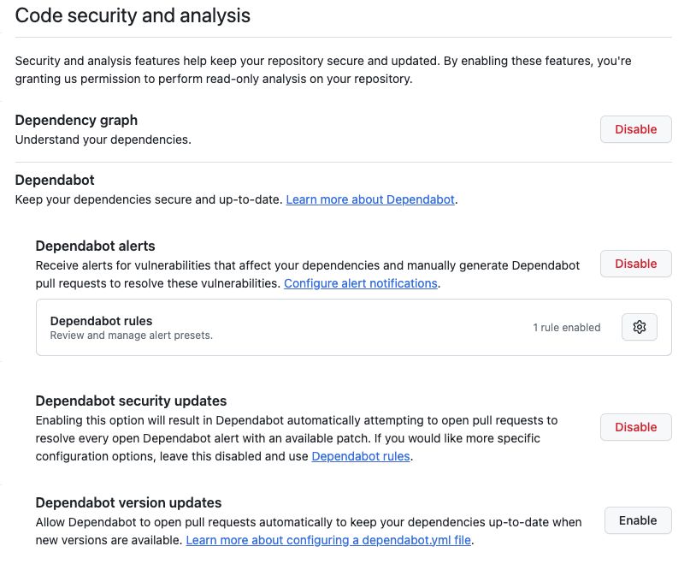
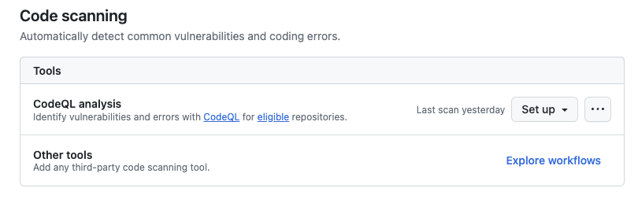
Code security and analysis
With code security and analysis, you can look for vulnerabilities. For CodeQL the repo must be public.
In this procedure, you’ll enable the following items:
Dependabot
CodeQL
Notes:
Speaker notes:
Now that Application Insights is configured, you can use the service to monitor what's happening in your application.
In this unit, you'll view the following items:
The Application Map
Performance data
Failures
Metrics
Live Metrics
Availability
Logs
To analyze monitoring data, do the procedure.

Slide 29
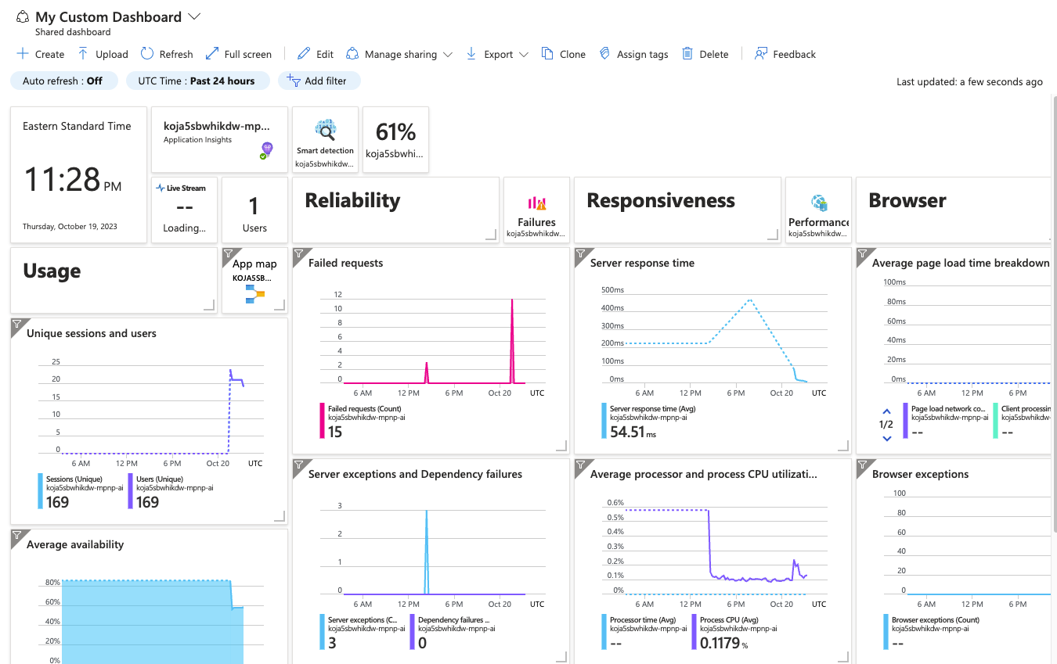
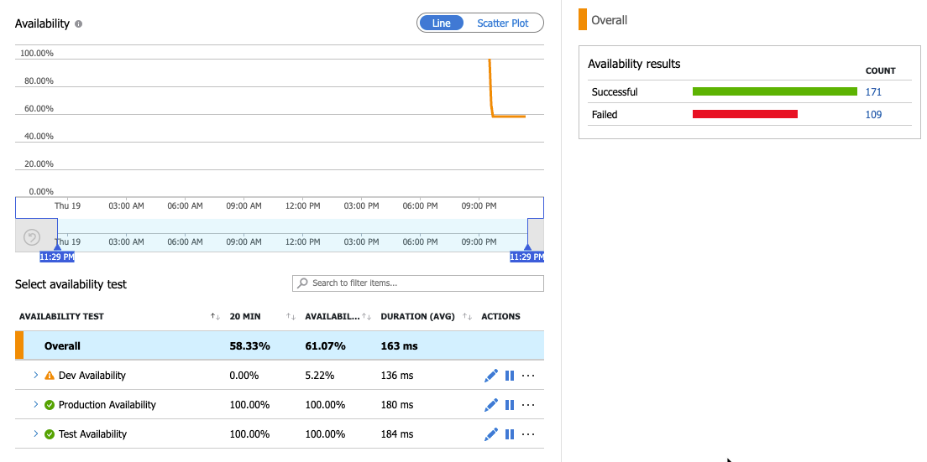
Monitor the Application
With the data from the application being logged to Log Analytics, you can create dashboards and monitoring.
In this section, you’ll work with app insights
Customize the App Insights Dashboard
Setup availability monitoring
View availability alerting
Notes:
Speaker notes:
Now that you’ve been collecting log data from your Spring Apps Service, your next step will be to query the log data.
In this section, you'll view the following entries:
Log entries containing errors or exceptions
Ingress log entries.
Container log entries
To view the log entries, do the following procedures.

